Slide 1
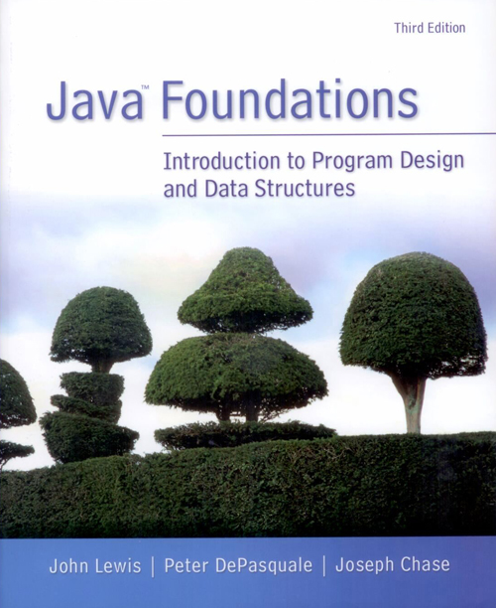
Chapter 1
Introduction

Slide 2
Objectives
Introduce the Java programming language
Describe the steps involved in program compilation and execution
Discuss the activities involved in the software development process

Slide 3
Content
The Java programming language
Program development
Problem solving
Software development activities
Object-oriented programming

Slide 4
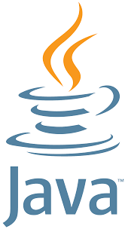
1. The Java programming language

Slide 5
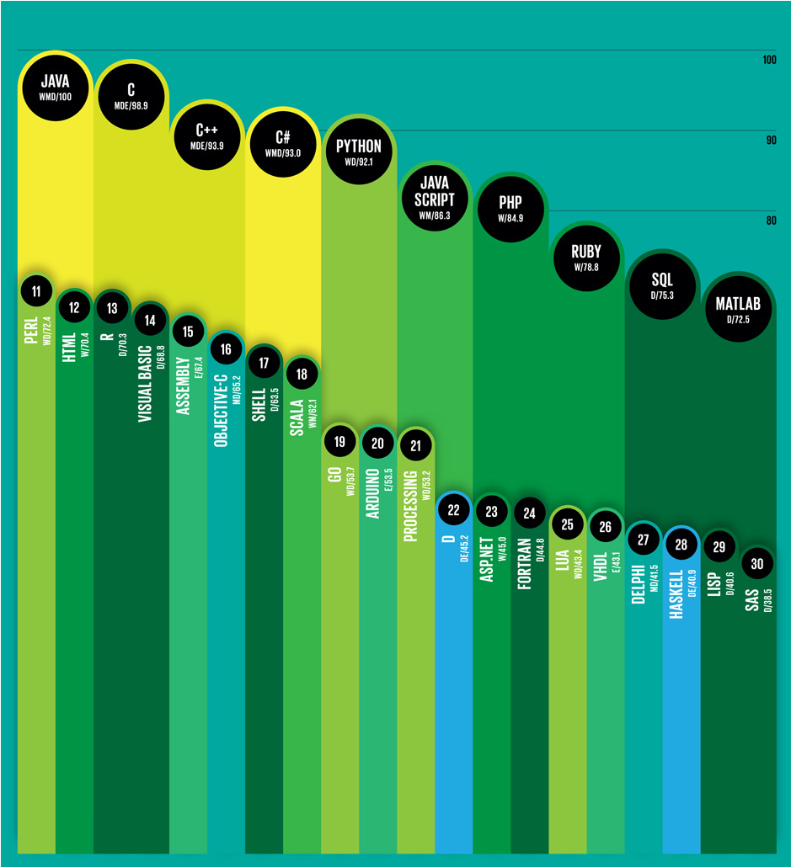
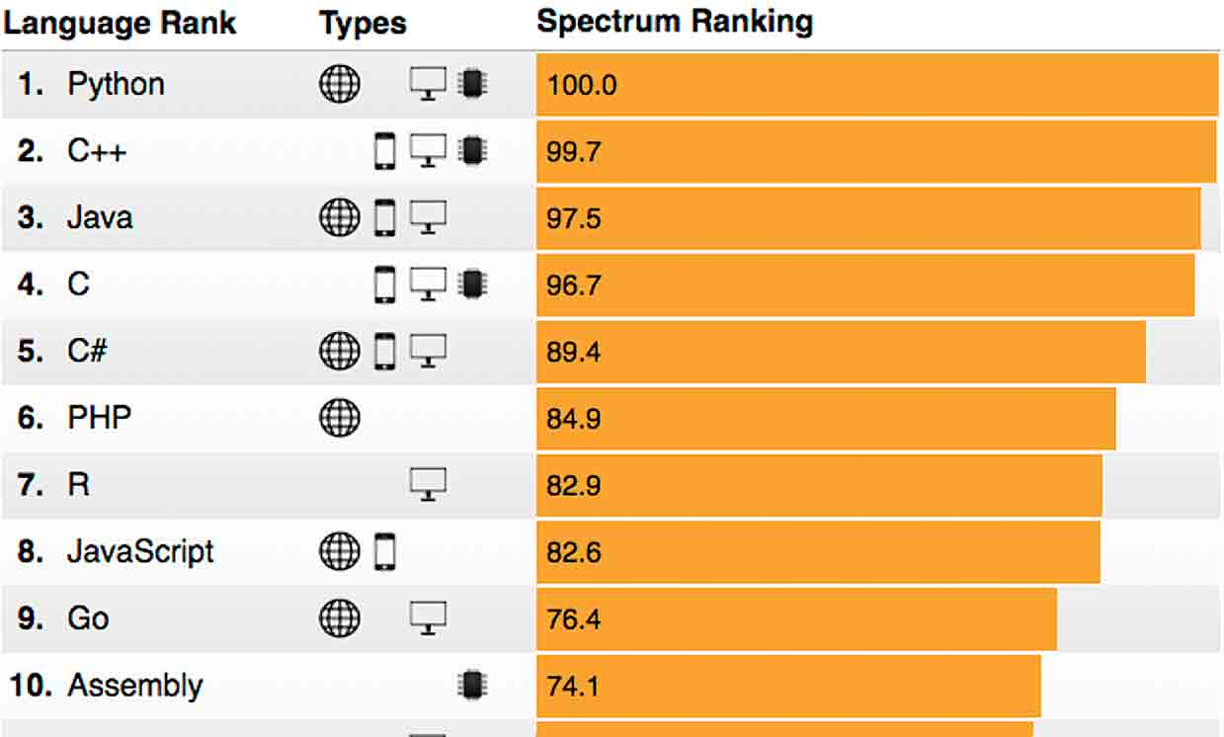
Many high-level programming languages
Why Java?
Different sources show a bit different ranking.
Source: https://spectrum.ieee.org/at-work/innovation/the-2018-top-programming-languages

Slide 6
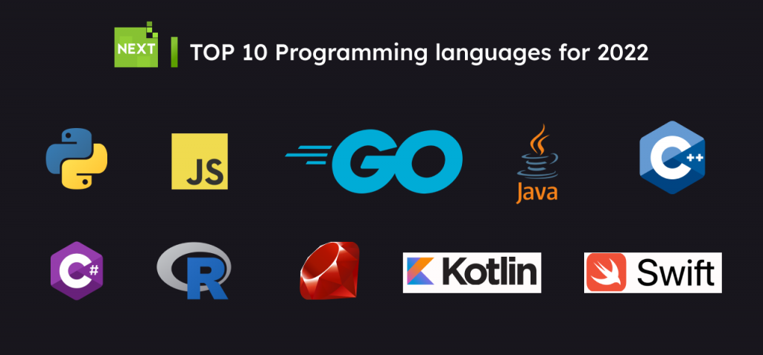
Source: https://nexttechnology.io/top-10-programming-languages-for-2022/

Slide 7
Areas where programming languages are mostly used
Java
Mobile apps
General applications
Python
Machine learning
C/C++
System software
Real time applications
IoT
JavaScript and HTML
Web applications
SQL (not a programming language)
Databases
Note that Java, Python, C/C++, and JavaScript are general-purpose programming languages.

Slide 8
Java programming language
Program?
Programming?

Slide 9
A computer is made up of hardware on which programs run.
hardware – the physical, tangible pieces that support the computing effort
program – a series of instructions that the hardware executes one after another
Programs are sometimes called applications
software – consists of programs and the data those programs use
Computer programming is ...

Slide 10
Computer programming is the process of designing and building a computer program to solve problems.
Algorithms
Coding
Coding means ...

Slide 11
Syntax
Java
A programming language specifies the words and symbols that we can use to write a program.
A programming language employs a set of rules that dictate how the words and symbols can be put together to form valid program statements.
The Java programming language was created by Sun Microsystems, Inc.
It was introduced in 1995 and its popularity grew quickly.

Slide 12
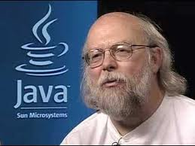
James Gosling

Slide 13
main()
…
+++
---
In the Java programming language,
a program is made up of one or more classes
Usually a class is defined in a file.
a class contains one or more methods
a method contains program statements
The above three terms will be explored in detail throughout the course.
A Java application always contains a method called main(). Meaning?
???
&&&
***

Slide 14
1.1 A Java program
Got to remember
// in MyProgram.java,
// the file must be the same as the class name.
public class MyProgram
{
}
class header
class body (i.e., code block)
Comments can be placed almost anywhere
The meaning of public class will be discussed later.

Slide 15
//********************************************************************
// Lincoln.java Java Foundations
//
// Demonstrates the basic structure of a Java application.
//********************************************************************
public class Lincoln
{
//-----------------------------------------------------------------
// Prints a presidential quote.
//-----------------------------------------------------------------
public static void main(String[] args)
{
System.out.println("A quote by Abraham Lincoln:");
System.out.println(" Whatever you are, be a good one.");
}
}
End of a statement
Generally indentations use tabs or 4 (or 8) spaces.
Indentations for better readability

Slide 16
The file name?
// comments about the class
public class MyProgram
{
}
// comments about the method
public static void main(String[] args)
{
}
method header
method body
(i.e., code block)
The meaning of public static void will be discussed later.

Slide 17
1.2 Comments
Comments should be included to explain the purpose of the program and describe processing.
They do NOT affect how a program works. They are used for people.
Java comments can take two forms:
Inline comments
Block comments
// this comment runs to the end of the line
/* this comment runs to the terminating
symbol, even across line breaks */
/** this is a javadoc comment */

Slide 18
1.3 Identifiers
public, class, Lincoln, void, main,
String, args, System, out, println
Identifiers are the words a programmer uses in a program.
can be made up of letters, digits, the underscore character ( _ ), and the dollar symbol ($). Test, test2, test_3, $test
cannot begin with a digit. 3tests, 4_tests
Java is case sensitive
Total, total, and TOTAL are different identifiers.
By convention, programmers use different case styles for different types of identifiers, such as
title case for class names - Lincoln
upper case for constants - MAXIMUM

Slide 19
Two types of identifiers: User-defined, reserved
User-defined identifiers:
Sometimes we choose identifiers ourselves when writing a program (such as Lincoln).
Sometimes we are using another programmer's code, so we use the identifiers that he or she chose (such as println).
Reserved words:
Often we use special identifiers called reserved words that already have a predefined meaning in the language.
A reserved word CANNOT be used in any other way (i.e., variables, class and method names).
Parts of a programming language

Slide 20
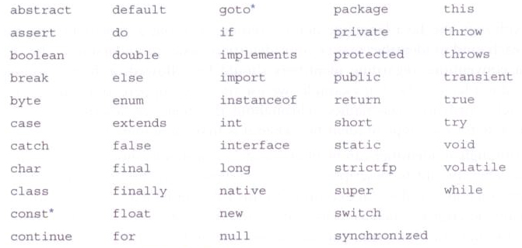
Reserved words
Java reserved words: (You do not have to memorize them all now.)

Slide 21
/*********************************************************************
* Lincoln.java Java Foundations
*
* Demonstrates the basic structure of a Java application.
*********************************************************************/
public class Lincoln
{
//-----------------------------------------------------------------
// Prints a presidential quote.
//-----------------------------------------------------------------
public static void main(String[] args)
{
System.out.println("A quote by Abraham Lincoln:");
System.out.println(" Whatever you are, be a good one.");
}
}
Can you find comments?
How many identifiers can you find?
Can you find reserved words?
Can you find user-defined identifiers?
The file name must be the same as the class name.
Novice programmers often make errors here.

Slide 22
1.4 White space
Spaces, blank lines, and tabs are called white space.
White space is used to separate words and symbols in a program.
Extra white space is ignored.
A valid Java program can be formatted many ways.
Programs should be formatted to enhance readability, using consistent indentation.

Slide 23
//********************************************************************
// Lincoln2.java Java Foundations
//
// Demonstrates a poorly formatted, though valid, program.
//********************************************************************
public class Lincoln2{public static void main(String[]args){
System.out.println("A quote by Abraham Lincoln:");
System.out.println(" Whatever you are, be a good one.");}}
Can you understand the above program?

Slide 24
//********************************************************************
// Lincoln3.java Java Foundations
//
// Demonstrates another valid program that is poorly formatted.
//********************************************************************
public class
Lincoln3
{
public
static
void
main
(
String
[]
args )
{
System.out.println (
"A quote by Abraham Lincoln:" )
; System.out.println
(
"Whatever you are, be a good one."
)
;} }
Can you understand this program?

Slide 25
//********************************************************************
// Lincoln2.java Java Foundations
//
// Demonstrates a poorly formatted, though valid, program.
//********************************************************************
public class Lincoln2{
public static void main(String[]args){
System.out.println("A quote by Abraham Lincoln:");
System.out.println(" Whatever you are, be a good one.");
}
}
What is wrong?
How can you improve the readability?

Slide 26
Intermediate Summary
Structure of a Java program
File, class, method, statement
Identifiers
User-define, reserved
Comments
For better understanding
White spaces
For the user readability
Space, tab, empty line – consistent indentations and line spaces are critical.

Slide 27
Content
The Java programming language
Program development
Problem solving
Software development activities
Object-oriented programming

Slide 28
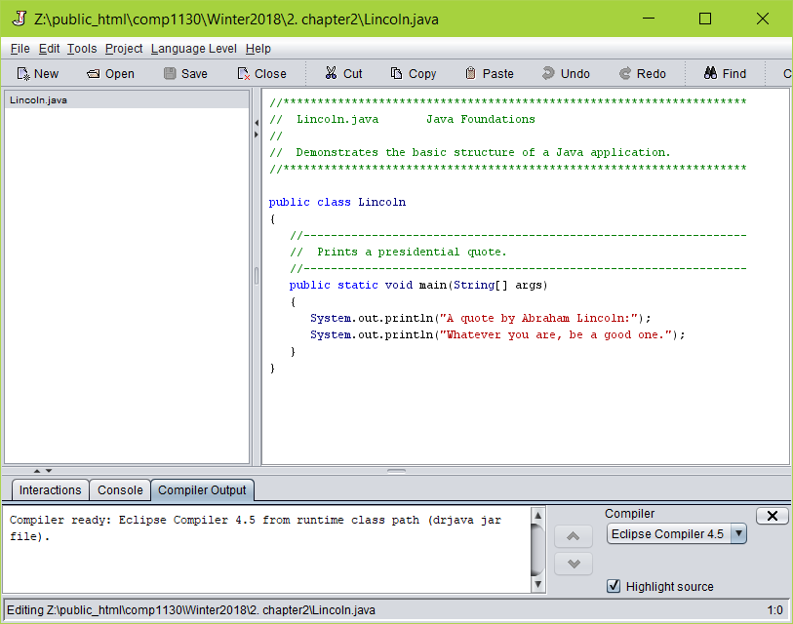
2. Program development
The mechanics of developing a program include several activities.
Thinking how and what to solve
writing the program in a specific programming language (such as Java)
translating the program into a form that the computer can execute
executing and testing to see if the program works correctly
investigating and fixing various types of errors that can occur
Software tools can be used to help with all parts of this process. E.g., DrJava, Geany, BlueJ, VS Code, …

Slide 29
2.1 Language Levels
There are four programming language levels.
machine language, and assembly language
high-level language, such as Java
fourth-generation language
Each type of CPU has its own specific machine language.
The other levels were created to make it easier for a human being to read and write programs.
Notes:
fourth-generation language: Often abbreviated 4GL, fourth-generation languages are programming languages closer to human languages than typical high-level programming languages. Most 4GLs are used to access databases.
A fourth generation (programming) language (4GL) is a grouping of programming languages that attempt to get closer than 3GLs to human language, form of thinking and conceptualization. 4GLs are designed to reduce the overall time, effort and cost of software development. The main domains and families of 4GLs are: database queries, report generators, data manipulation, analysis and reporting, screen painters and generators, GUI creators, mathematical optimization, web development and general purpose languages. Also known as a 4th generation language, a domain specific language, or a high productivity language.
Some examples of 4GL are: database query language e.g.SQL; Focus, Metafont, PostScript, S, IDL-PV, WAVE, Gauss, Mathematica, and data-stream languages such as AVS, APE, Iris Explorer

Slide 30
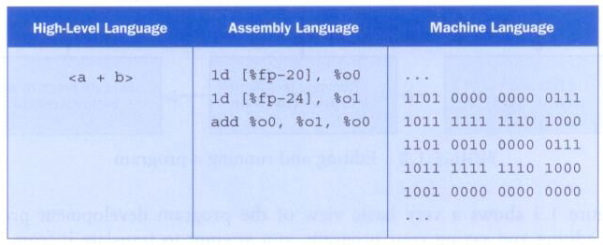
A high-level expression and its assembly/machine language equivalents:

Slide 31
2.2 Compilation
Each type of CPU executes only a particular machine language.
A program must be translated into machine language before it can be executed.
A compiler is a software tool which translates source code into a specific target language.
Often, that target language is the machine language for a particular CPU type.
The Java approach is somewhat different.

Slide 32
Basic Programming Steps
A program is written in an editor, compiled into an executable form, and then executed.
If errors occur during compilation, an executable version is not created.

Slide 33
Java Translation
The Java compiler translates Java source code into a special representation called bytecode.
Java bytecode is not the machine language for any traditional CPU.
Java interpreter (called Java Virtual Machine (JVM)) reads Java bytecode and executes it on a specific machine.
Another software tool, called an bytecode compiler, translates bytecode into machine language and executes it.
Therefore the Java compiler is not tied to any particular machine.
Java is considered to be architecture-neutral.
Notes:
http://www.coderanch.com/t/394556/java/java/Java-Interpreter-Compiler
The entire process would be something like this: you write your code and save it as a .java file. The compiler takes your .java file and compiles it into a .class file (the .class file contains Java byte code). The interpreter comes in when your program is run. The JVM (or interpreter) takes your .class file and interprets it. Keep in mind that more and more frequently as JIT becomes more prevalent it is code is not just interpreted anymore it is actually compiled at run time into native machine code. Each platform has a JVM written specifically for it so thatt he JVM for say a Macintosh knows exactly how to interpret the byte codes produced by the compiler (the .class file) and make them work on a mac, same for a Windows JVM.

Slide 34
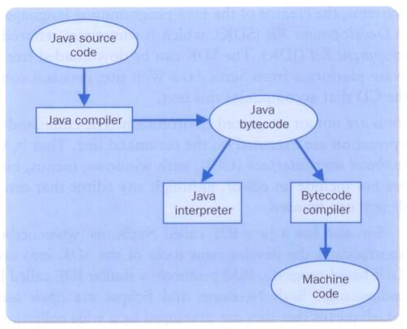
(.java files)
(.class files)
(Java Virtual Machine: JVM)
(JVMs for Windows, OS X, and Linux)
“Write Once and Run Anywhere”
Notes:
Compiled vs Interpreted
This document was written by CS 290W TA Joshua Kay and was last modified 02/23/1999 07:54:35
We want a language that can run on any machine, that the machine interprets."Interpreted" means that the computer looks at the language, and then turns it into native machine language.
Interpreted versus compiled -Interpretation happens at runtime, compiling happens when the writing of the program is finished. -Interpreted languages can run across platforms, compiled languages are native to one computer
But Java is compiled, too. What's going on?
Java is both compiled AND interpreted. What does this mean?
Java doesn't actually run on a PC or a Sun or a Mac. Java runs on the Java Virtual Machine (JVM)
When C++ code is compiled, it is compiled into Machine Language, or Native Binary Code, which is understood by the computer it was compiled on.
When Java code is compiled, it is compiled into Java ByteCode, which is understood by the JVM.
So, any computer which has the JVM installed can understand Java ByteCode.
example: I don't know German, and my new German friend doesn't know English. However, we both have a working knowledge of Spanish. So we can speak to each other. he can write something that I can understand, or vice versa.
How this works
We Install the Java Virtual Machine on a PC, and also on a Unix workstation.
We write a Java program on the PC, and compile it. This creates Java ByteCode.
We then run the program (via the Web) on the Unix workstation. The JVM on the Unix workstation Interprets the Java ByteCode, and creates Native Machine Language which the computer then executes.

Slide 35
Other native applications | Java applications
Geany, Google Chrome, javac, … | Java applications (classes)
 | JVM
Operating system such as Windows, Ubuntu, MacOS
Computer hardware
“Write Once and Run Anywhere”
Notes:
Compiled vs Interpreted
This document was written by CS 290W TA Joshua Kay and was last modified 02/23/1999 07:54:35
We want a language that can run on any machine, that the machine interprets."Interpreted" means that the computer looks at the language, and then turns it into native machine language.
Interpreted versus compiled -Interpretation happens at runtime, compiling happens when the writing of the program is finished. -Interpreted languages can run across platforms, compiled languages are native to one computer
But Java is compiled, too. What's going on?
Java is both compiled AND interpreted. What does this mean?
Java doesn't actually run on a PC or a Sun or a Mac. Java runs on the Java Virtual Machine (JVM)
When C++ code is compiled, it is compiled into Machine Language, or Native Binary Code, which is understood by the computer it was compiled on.
When Java code is compiled, it is compiled into Java ByteCode, which is understood by the JVM.
So, any computer which has the JVM installed can understand Java ByteCode.
example: I don't know German, and my new German friend doesn't know English. However, we both have a working knowledge of Spanish. So we can speak to each other. he can write something that I can understand, or vice versa.
How this works
We Install the Java Virtual Machine on a PC, and also on a Unix workstation.
We write a Java program on the PC, and compile it. This creates Java ByteCode.
We then run the program (via the Web) on the Unix workstation. The JVM on the Unix workstation Interprets the Java ByteCode, and creates Native Machine Language which the computer then executes.

Slide 36
Difference between Compiler and Interpreter
 | Compiler | Interpreter
1 | Compiler Takes Entire program as input | Interpreter Takes Single instruction as input .
2 | Intermediate Object Code is Generated | No Intermediate Object Code is Generated
3 | Conditional Control Statements are Executes faster | Conditional Control Statements are Executes slower
4 | Memory Requirement : More(Since Object Code is Generated) | Memory Requirement is Less
5 | Program need not be compiled every time | Every time higher level program is converted into lower level program
6 | Errors are displayed after entire program is checked | Errors are displayed for every instruction interpreted (if any)
7 | Example : C, C++ Compiler | Example : BASIC, JavaScript, Perl, Python
http://www.c4learn.com/c-programming/compiler-vs-interpreter/

Slide 37
2.3 Development Environments
A development environment is the set of tools used to create, test, and modify a program.
An integrated development environment (IDE) combines the tools into one software program.
All development environments contain key tools, such as a compiler and/or interpreter.
Others include additional tools, such as a debugger, which helps you find errors.

Slide 38
There are many environments that support the development of Java software, including:
Oracle Java Development Kit (JDK), OpenJDK
Eclipse
NetBeans
BlueJ
VS Code
Geany in this course – https://www.geany.org/
Though the details of these environments differ, the basic compilation and execution process is essentially the same.

Slide 39
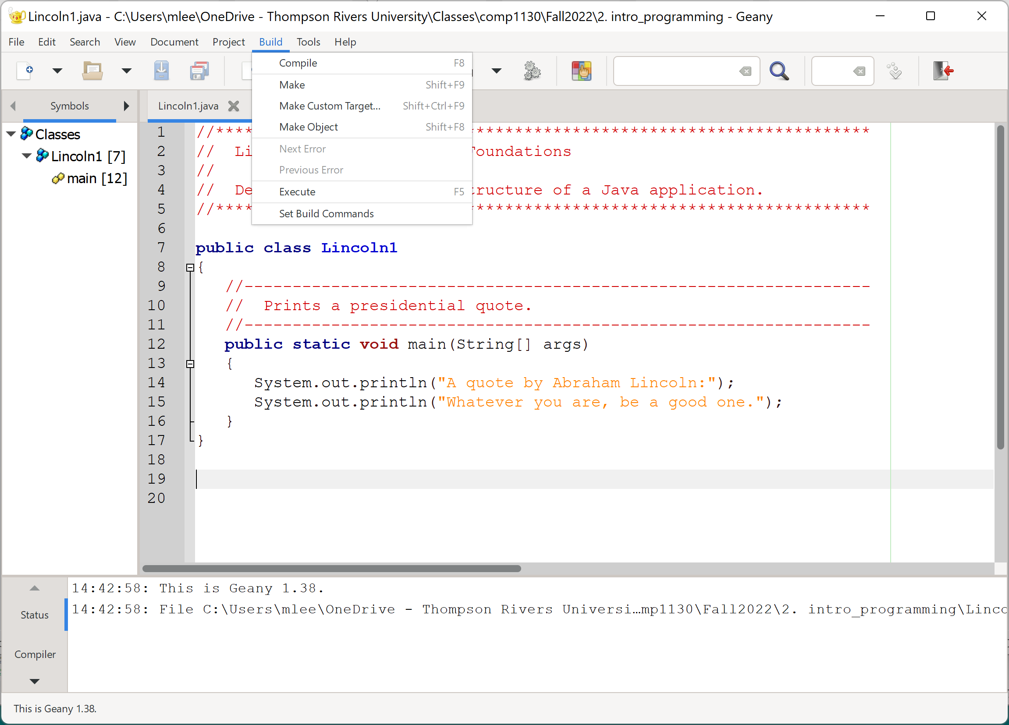
Geany in this course – https://www.geany.org/
Compile and run the posted Java programs

Slide 40
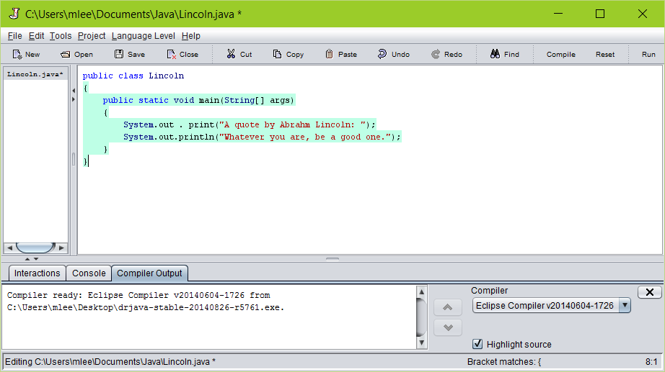
Another example, DrJava – http://www.drjava.org
Compile and run the posted Java programs

Slide 41
Try the next programs from the Moodle or the course web site.
https://cs.tru.ca/~mlee/comp1130/Fall2022/2.%20introduction_to_programming.html
Lincoln.java
Lincoln2.java
Lincoln3.java

Slide 42
2.4 Syntax and Semantics
The syntax rules of a language define how we can put together symbols, reserved words, and identifiers to make a valid program.
The semantics of a program statement define what that statement means (its purpose or role in a program).
A program that is syntactically correct is not necessarily logically (semantically) correct.
A program will always do what we tell it to do, not what we meant to tell it to do.

Slide 43
2.5 Errors
A program can have three types of errors:
The compiler will find syntax errors and other basic problems (compile-time errors).
E.g., public class { ... }
A problem can occur during program execution, such as trying to divide by zero, which causes a program to terminate abnormally (run-time errors).
E.g., float x = 0; float y; y = 150 / x;
A program may run, but produce incorrect results, perhaps using an incorrect formula/algorithm (logical errors) .

Slide 44
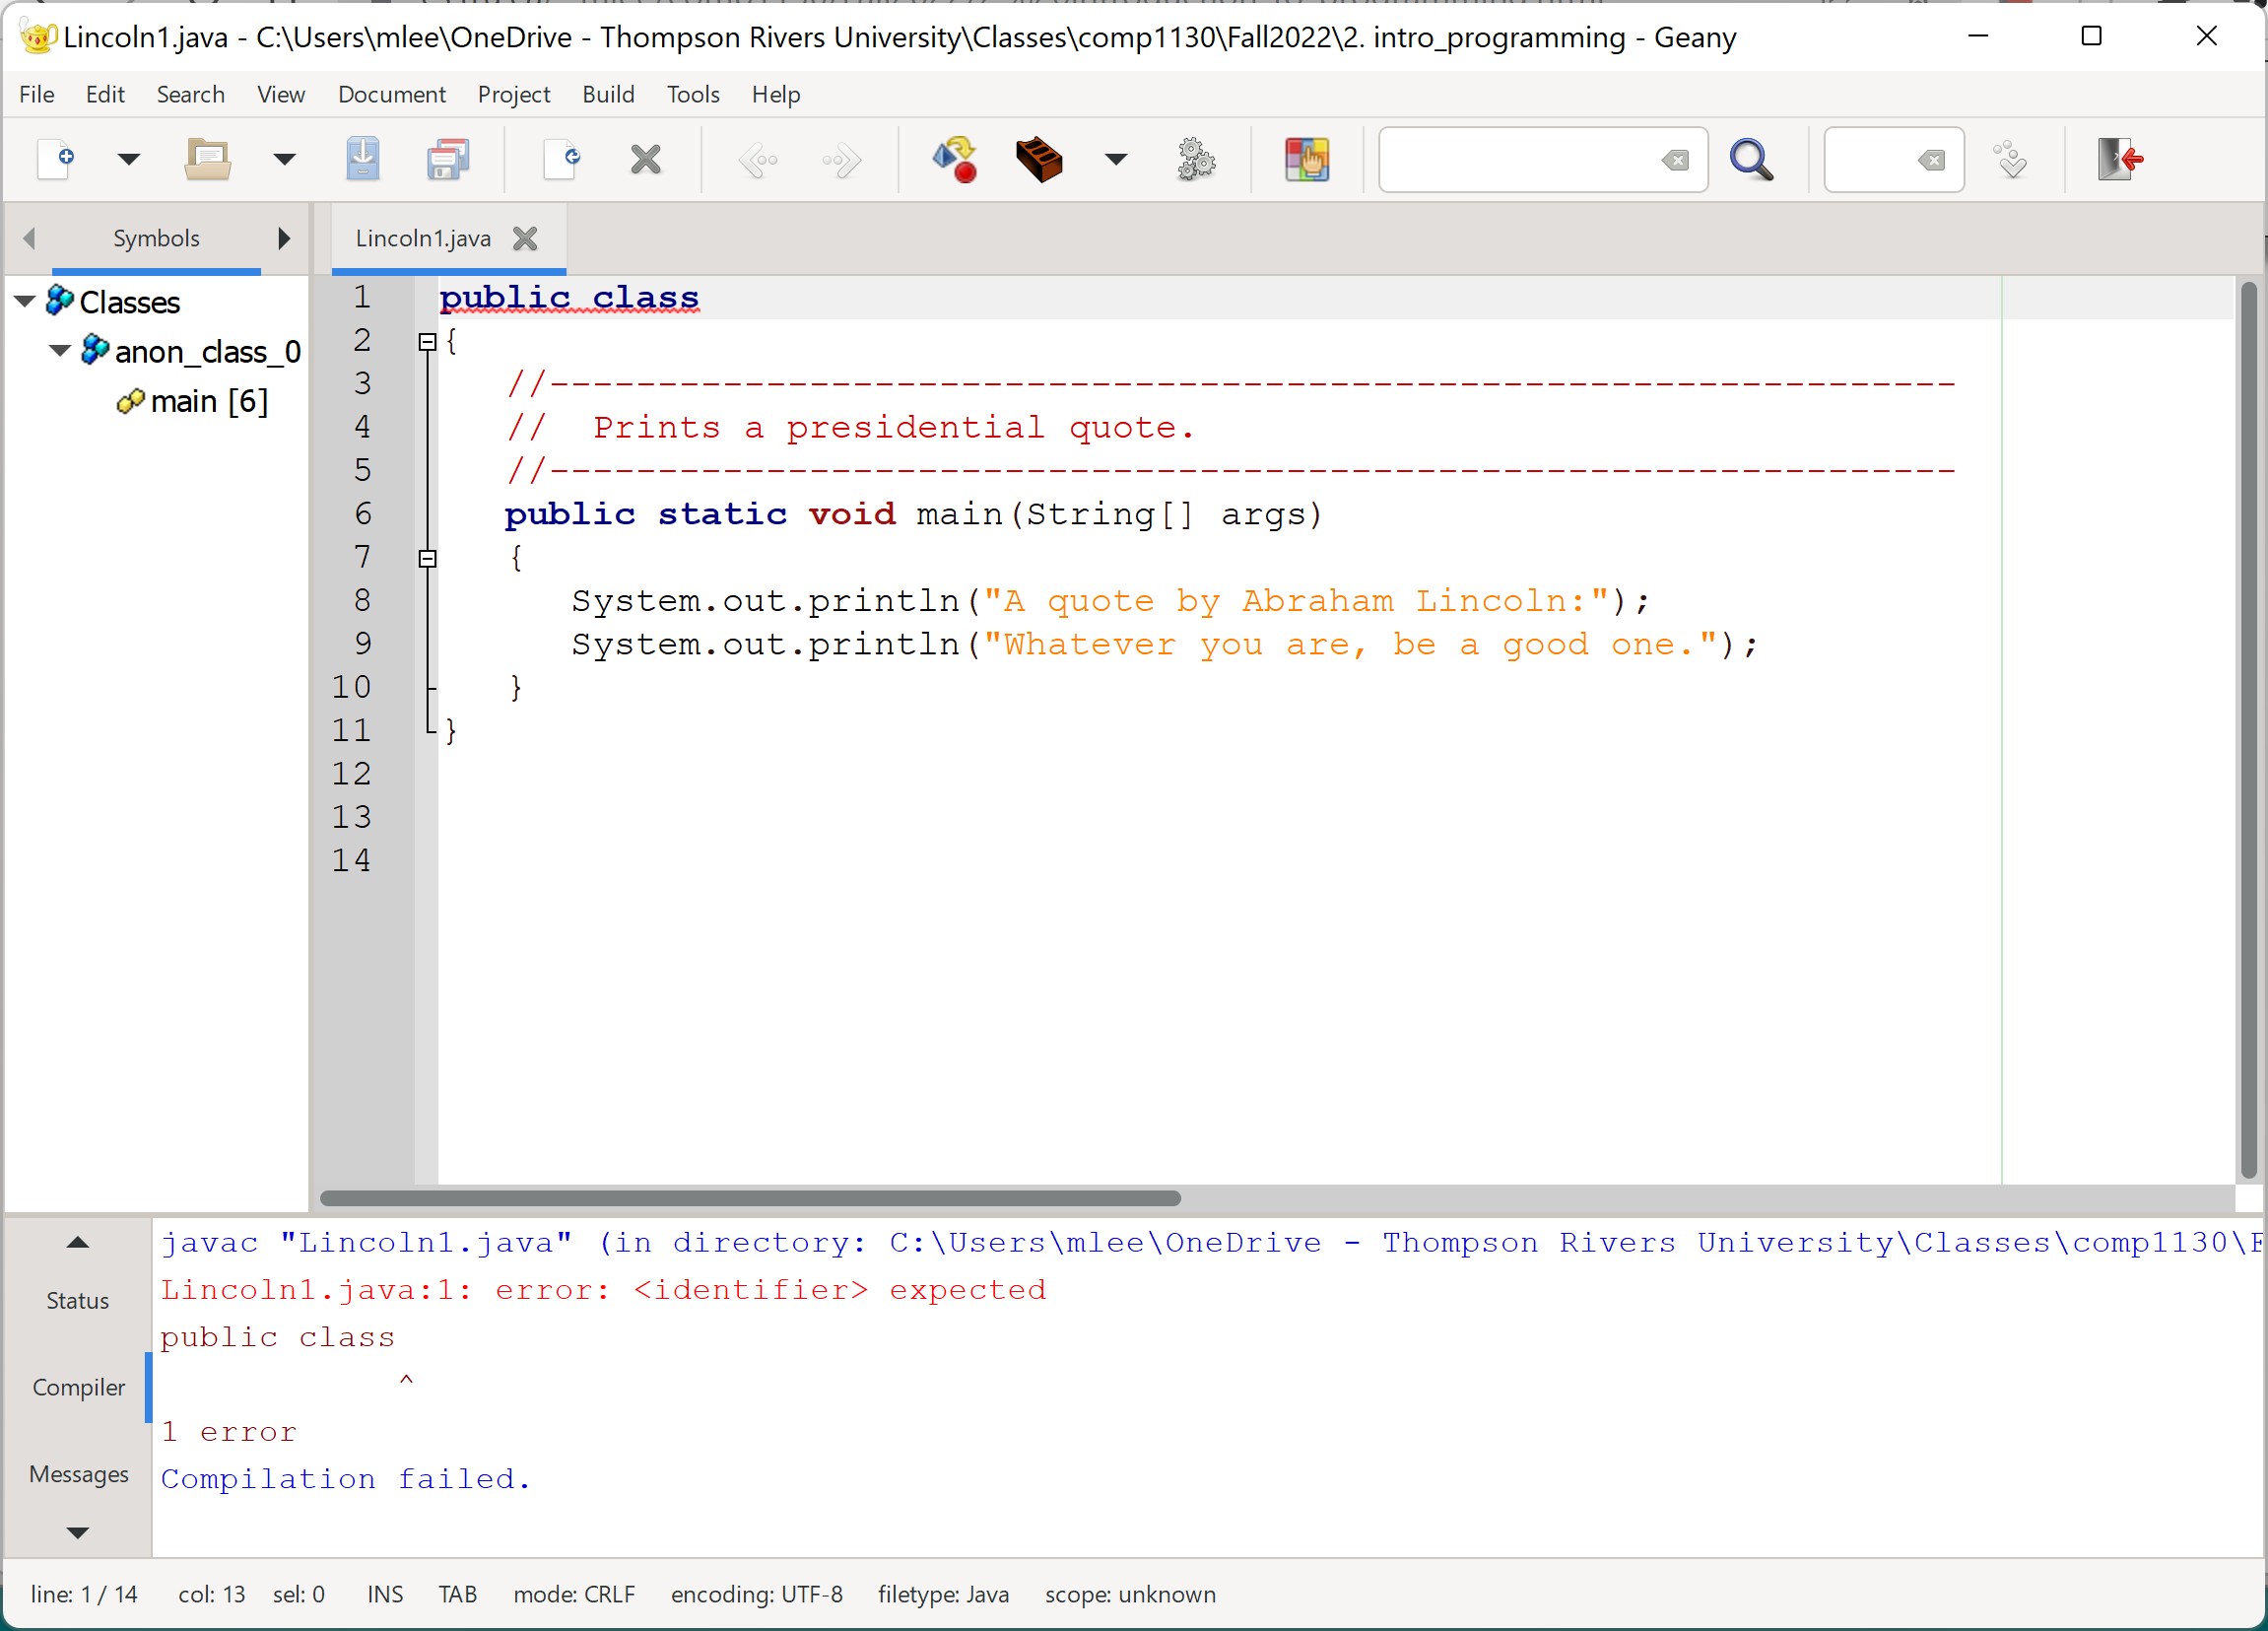
Example of Geany

Slide 45
Example of DrJava

Slide 46
Try the next programs from the Moodle or the course web page.
https://cs.tru.ca/~mlee/comp1130/Fall2022/2.%20introduction_to_programming.html
Lincoln4.java
Lincoln5.java
Wrong programming habit:
Poor indentation,
Naming convention
Common errors:
File name,
Case sensitive identifiers,
Missing of brackets

Slide 47
Intermediate Summary
High-level languages vs machine level languages
Compilation
Interpretation
IDE
Geany, DrJava
Syntax and semantics, and errors
Syntax errors, run-time errors, logical errors

Slide 48
Content
The Java programming language
Program development
Problem solving
Software development activities
Object-oriented programming

Slide 49
3. Problem Solving
The purpose of writing a program is to solve a problem.
Solving a problem consists of multiple activities.
understand the problem
design a solution (i.e., how to solve)
consider alternatives and refine the solution
implement the solution
test the solution
These activities are not purely linear – they overlap and interact.
Most important activity?

Slide 50
A key to designing a solution is breaking it down into manageable pieces. – divide and conquer strategy (It makes us think/solve the problem more easily.)
E.g., 1 + 2 + ... + 99 + 100
(1 + 2 + ... + 49 + 50) + (51 + ... + 100)
((1+...+25) + (26+...+50)) + ((51+...+75) + (75+…+100))
...
One good idea

Slide 51
A key to designing a solution is breaking it down into manageable pieces. – divide and conquer strategy (It makes us think/solve the problem more easily.)
When writing software, we design separate pieces that are responsible for certain parts of the solution.
An object-oriented approach, that is used in Java, lends itself to this kind of solution decomposition.
We will dissect our solutions into pieces called objects and classes. (Note that classes are descriptions/definitions of objects.)

Slide 52
Is there a king’s way to learn problem solving skills?
Think/study, …
Practice, …
Trial and error, …

Slide 53
E.g., SHE-GOAT, WOLF AND CABBAGE
A farmer returns from the market, where he bought a she-goat, a cabbage and a wolf. On the way home he must cross a river. His boat is small and won't fit more than one of his purchases. He cannot leave the she-goat alone with the cabbage (because the she-goat would eat it), nor he can leave the she-goat alone with the wolf (because the she-goat would be eaten). How can the farmer get everything on the other side in this river crossing puzzle?

Slide 54
E.g., Ferrying Soldiers
A detachment of 25 soldiers must cross a wide and deep river with no bridge in sight. They notice two 12-year-old boys playing in a rowboat by the shore. The boat is so tiny, however, that it can only hold two boys or one soldier. How can the soldiers get across the river and leave the boys in joint possession of the boat? How many times does the boat pass from shore to shore in your algorithm?
(Resource: Algorithmic Puzzle by Anany Levitin and Maria Levitin)

Slide 55
Content
The Java programming language
Program development
Problem solving
Software development activities
Object-oriented programming

Slide 56
4. Development Activities
Any proper software development effort consists of four basic development activities.
understanding, and establishing the requirements
creating a design
implementing the design
testing
These steps also are never purely linear and often overlap and interact.

Slide 57
Software requirements specify what a program must accomplish. [You have to understand it.]
Requirements are expressed in a document called a functional specification.
A software design indicates how a program will accomplish its requirements. [You have to understand it.]
Implementation is the process of writing the source code that will solve the problem.
Testing is the act of ensuring that a program will solve the intended problem given all of the constraints under which it must perform.

Slide 58
Content
The Java programming language
Program development
Problem solving
Software development activities
Object-oriented programming

Slide 59
5. Object-Oriented Programming
A key to designing a solution is breaking it down into manageable pieces. – divide and conquer strategy
Java is an object-oriented programming language.
As the term implies, an object is a fundamental entity in a Java program, especially when the program is running.
Objects can be used effectively to represent real-world entities.
For instance, an object might represent a particular employee in a company.
Each employee object handles the processing and data management related to that employee.

Slide 60
Objects
An object has
state (oac attributes, properties) - descriptive characteristics, i.e., data
behaviors (oac methods) - what it can do (or what can be done to it)
E.g., an object of bank account
The state of a bank account includes
account number
current balance.
The behaviors associated with a bank account include
the ability to make deposits and
withdrawals.
Note that the behavior of an object might change its state.

Slide 61
http://www.vijaywebsolutions.com/introduction-to-object-oriented-programming-classes/

Slide 62
What are classes?
What are objects?

Slide 63
Classes
AhHa
(public class Lincoln)
An object is defined by a class.
A class is the blueprint of an object.
The class uses methods to define the behaviors of the object.
The class that contains the main() method of a Java program represents the entire program. It is the starting point of the program.
A class represents a concept, and an object represents the embodiment of that concept.
Multiple objects can be created from the same class.

Slide 64
The class of an object is specified in a Java file.
When the Java file is compiled and executed, the real object will be created and used during the running time.

Slide 65
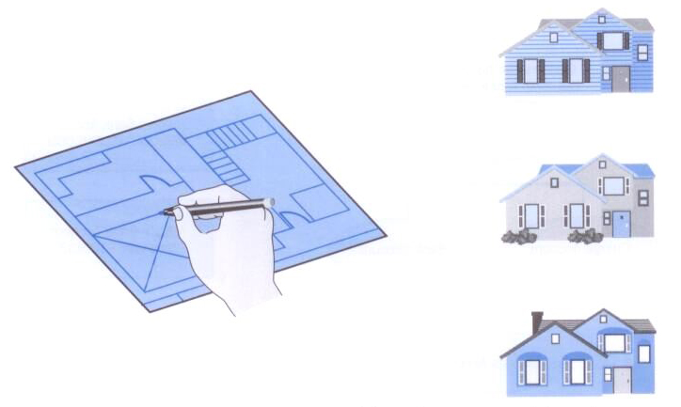
Classes and Objects
A class is like a blueprint from which you can create many of the "same" house with different characteristics.

Slide 66
Cookie cutter
(Class)
Cookies
(Objects)

Slide 67
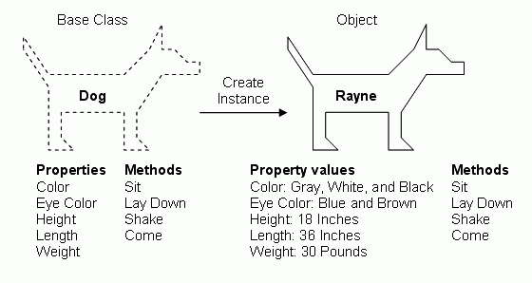

Slide 68
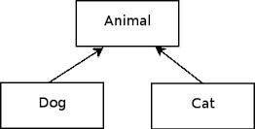
An object is encapsulated, protecting the data it manages.
One class can be used to derive another via inheritance.
Classes can be organized into hierarchies.
This topic will be discussed later.
Notes:
Encapsulation: Information hiding
Inheritance: software resue

Slide 69
Encapsulation
This topic will be discussed later.

Slide 70
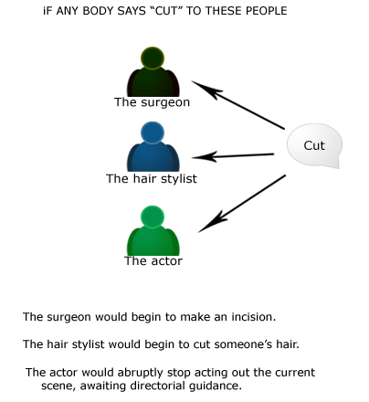
Classes and Objects
Polymorphism is the idea that we can refer to multiple types of related objects over time in consistent ways.
This topic will be discussed later.
Source: http://javanepal.wordpress.com/2008/10/22/polymorphism-on-three-classes/

Slide 71
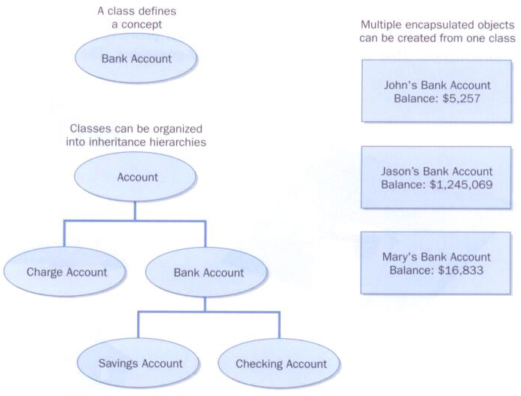
This topic will be discussed later.

